Slide 1
Gliding Car
By Arnav Gupta & Hamza Siddiqui

Slide 2
Gliding car with paper wings can smoothly glide off of a table, land on the floor, and continue to roll around 3 feet.
Project Goal

Slide 3
The Experiment

Slide 4
Materials
6 craft sticks
4 half-sticks
2 straws
2 wooden sticks
4 wheels
1 construction paper
Tape
Glue Gun
Most of the materials found around your house!

Slide 5
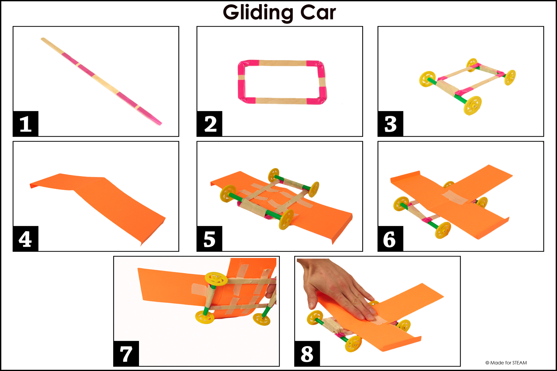
Procedure
Gather all the materials needed.
Make a wooden frame out of craft sticks and glue them together.
Build two wheel sets with straws, wooden sticks and wheels.
Attach the two wheel sets to the wooden frame.
Add the weight (4 half-sticks) to the front of the wooden frame.
Cut the construction paper to make the wing and the tail.
Attach the wing and tail at the top of the wooden frame (add tape to make secure.)

Slide 6
Hypothesis

Slide 7
Hypothesis Claim
When we launch the gliding car off the table, then it will glide for few feet in the air and land safely on the ground…

Slide 8
Hypothesis support
Below science principles works on gliding car -
Weight pulls the car downward, which causes air to push upward against the wings.
Lift causes air (or another gas/fluid) pushes against an object, typically upward.
Drag occurs when air (or other gas /fluid) pushes backward against a moving object.
Variables that may affect the outcome…
Shape and size of paper wing and tail.
Shape of gliding car’s frame.
Position of the gliding car’s tail.

Slide 9
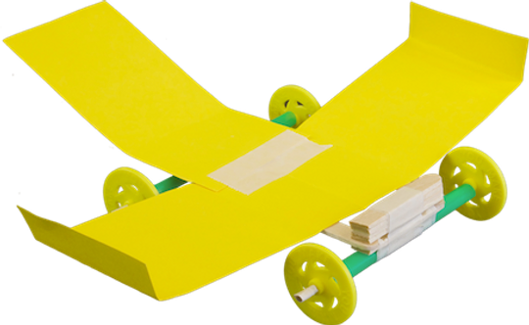
Gliding Car

Slide 10
Conclusion
Gliding is an energy-efficient driving mode achieved by turning off the internal combustion engine while the vehicle is still moving in order to save fuel.

